Slide 1
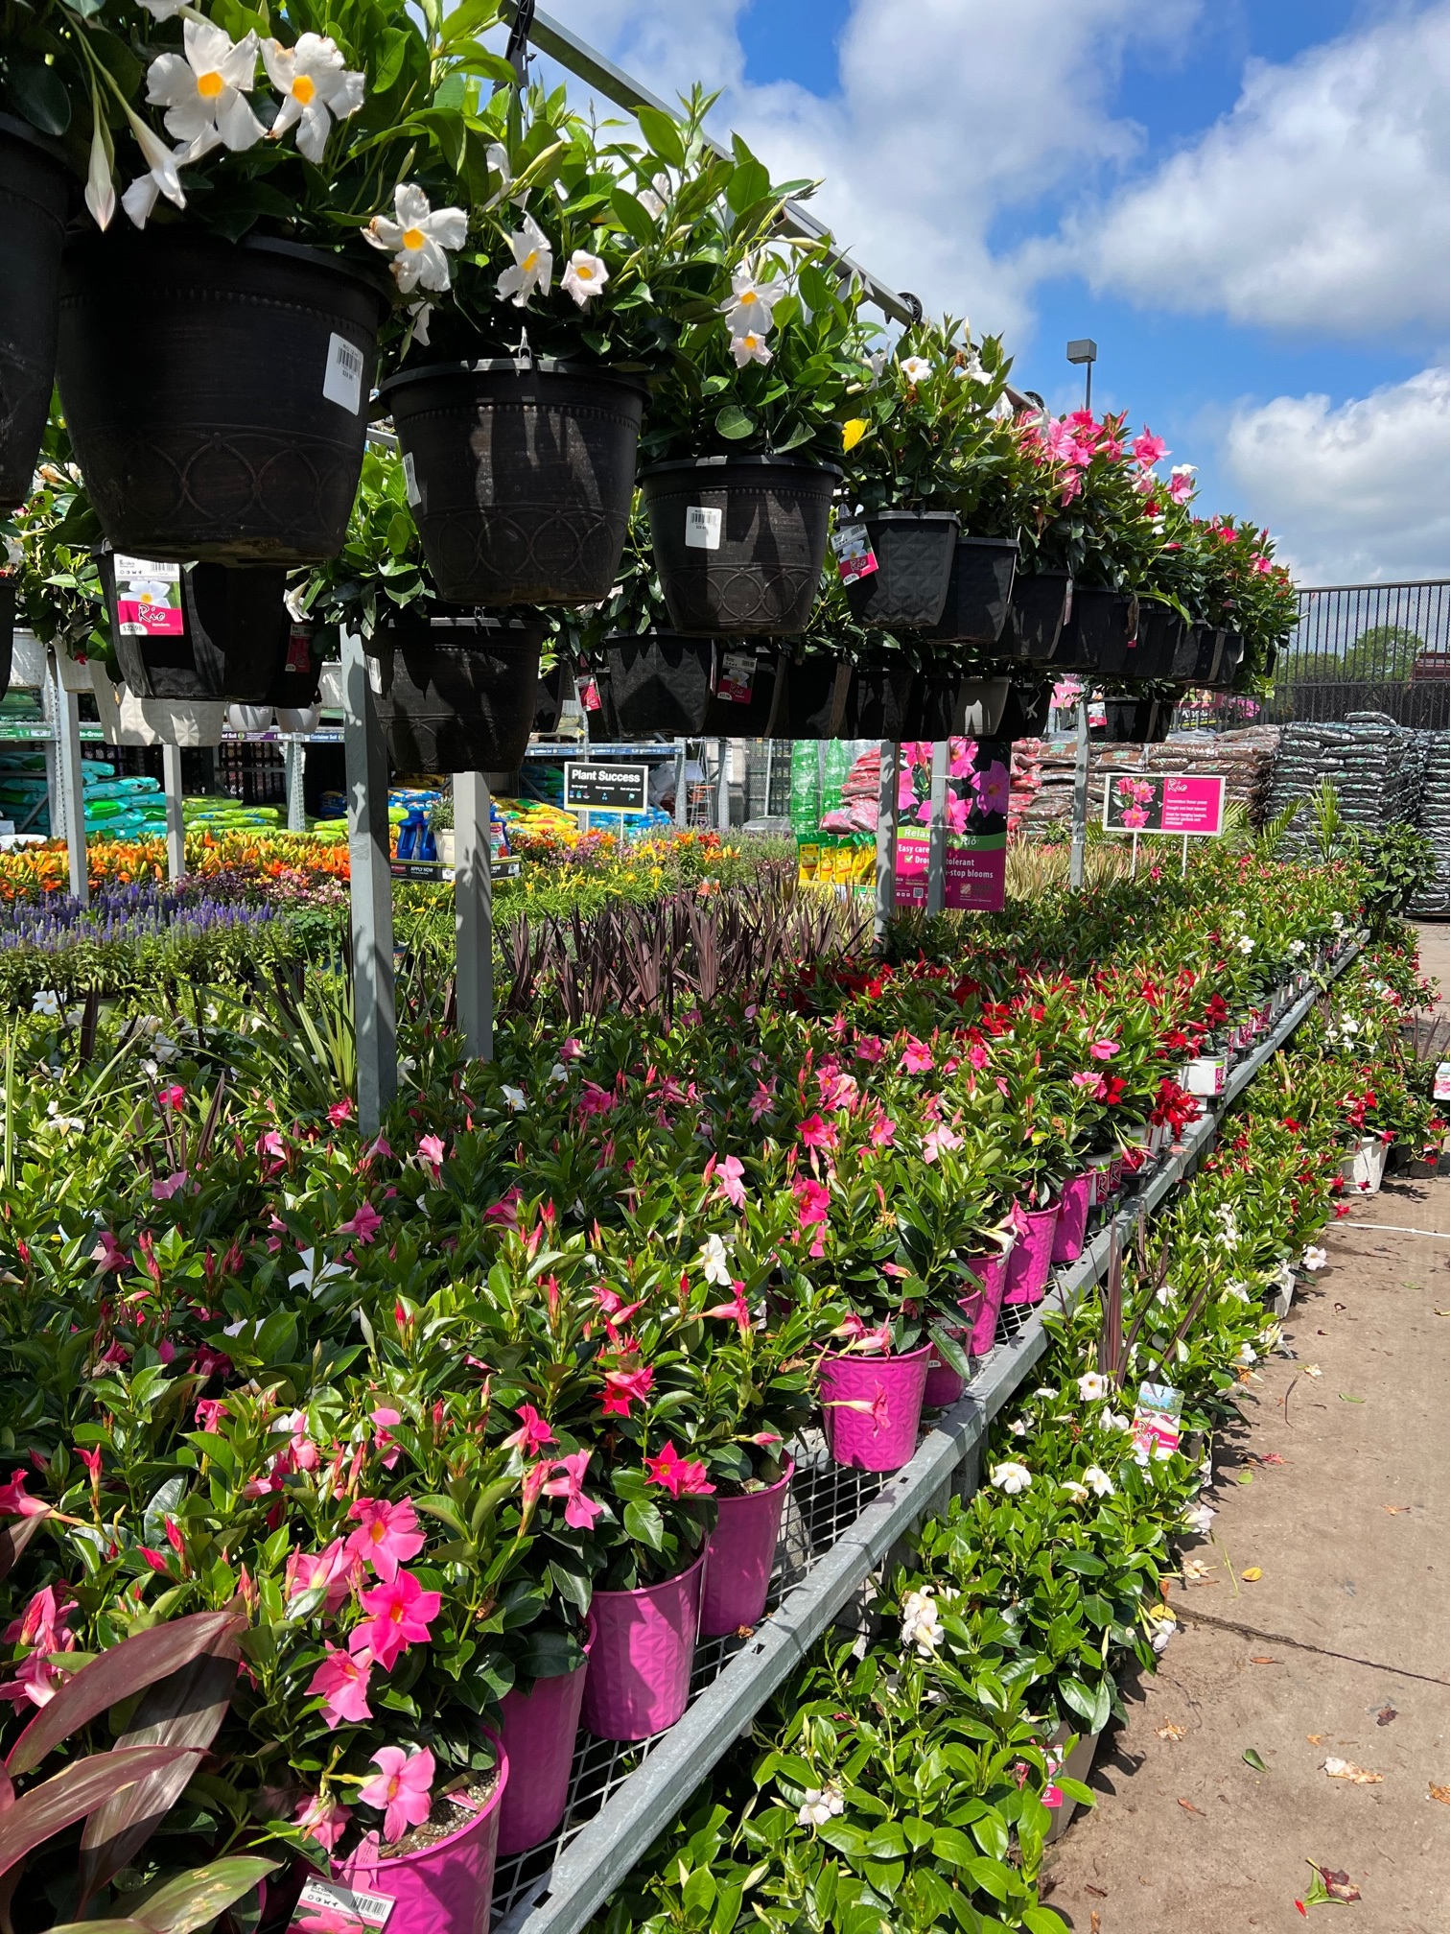
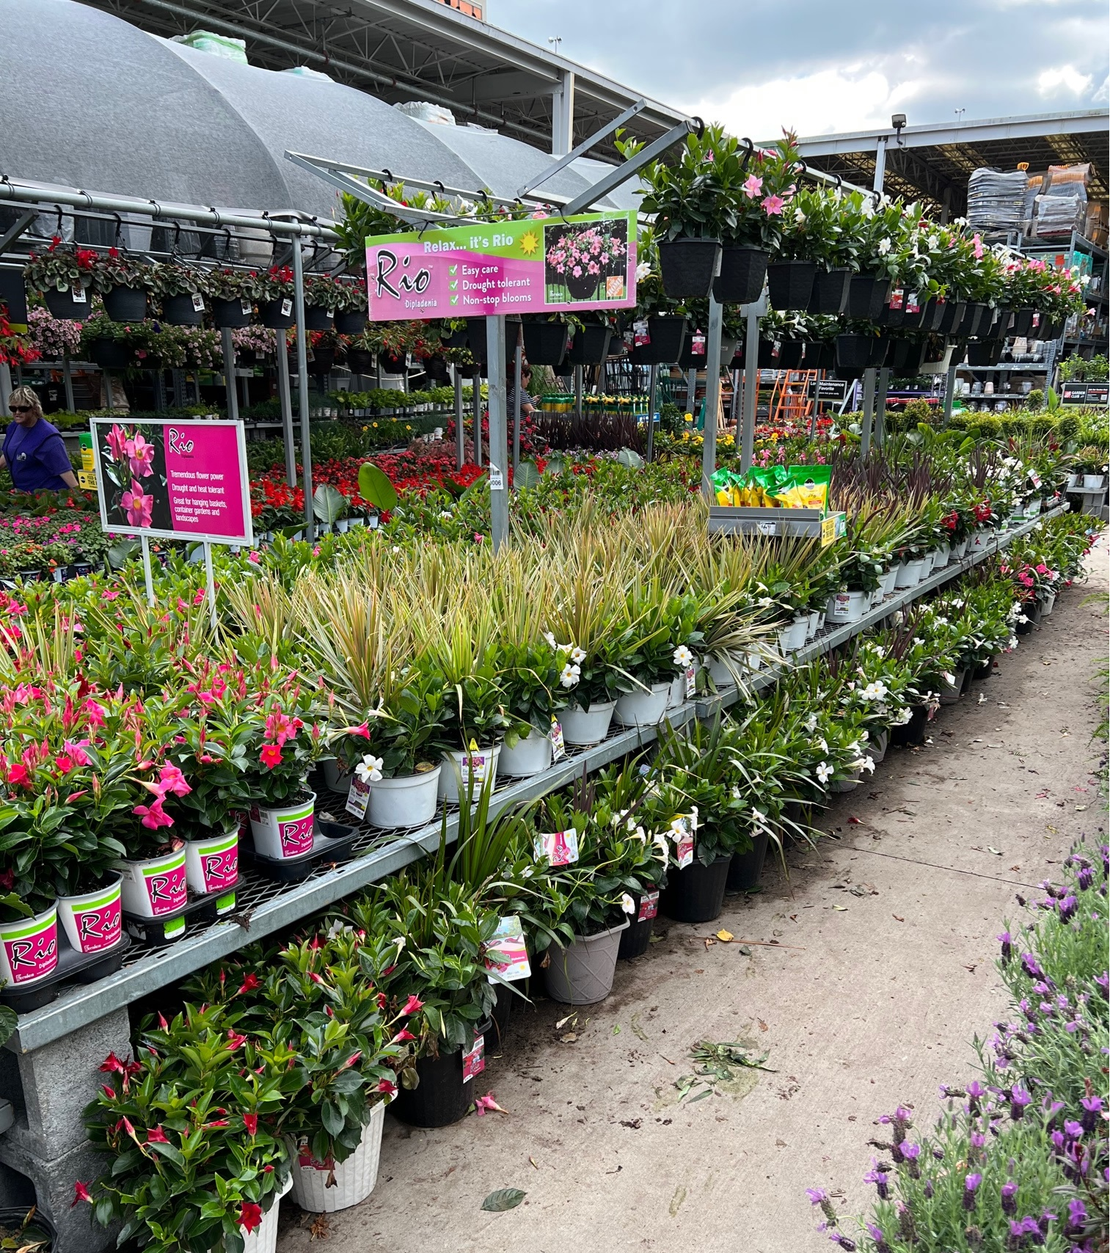
MERCHANDISING BEST PRACTICES
TABLES
Price points together and ascending front to back.
Color blocked and striped
Signed
fernlea.com/Rio

Slide 2
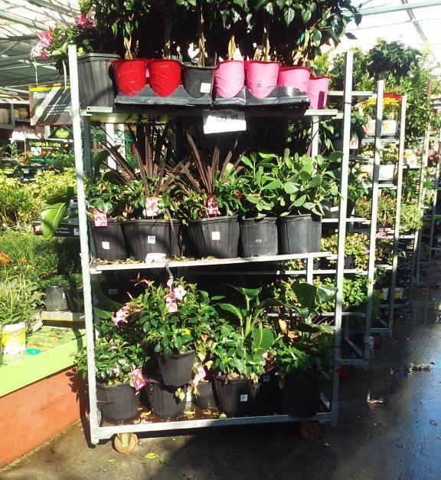
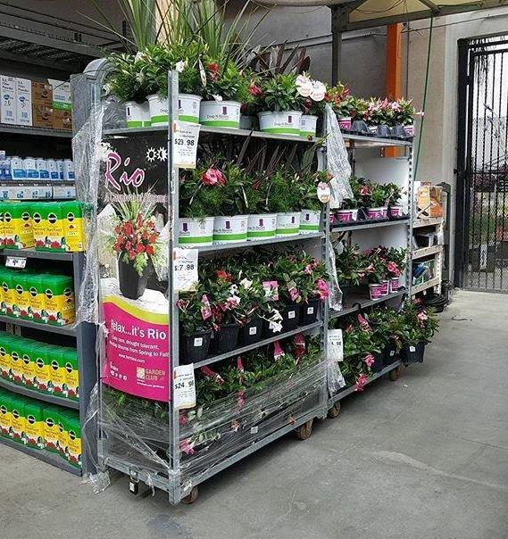
MERCHANDISING BEST PRACTICES
Mixed items, no pricing, messy display
Items not condensed, shrink wrap should be completely removed
fernlea.com/Rio

Slide 3
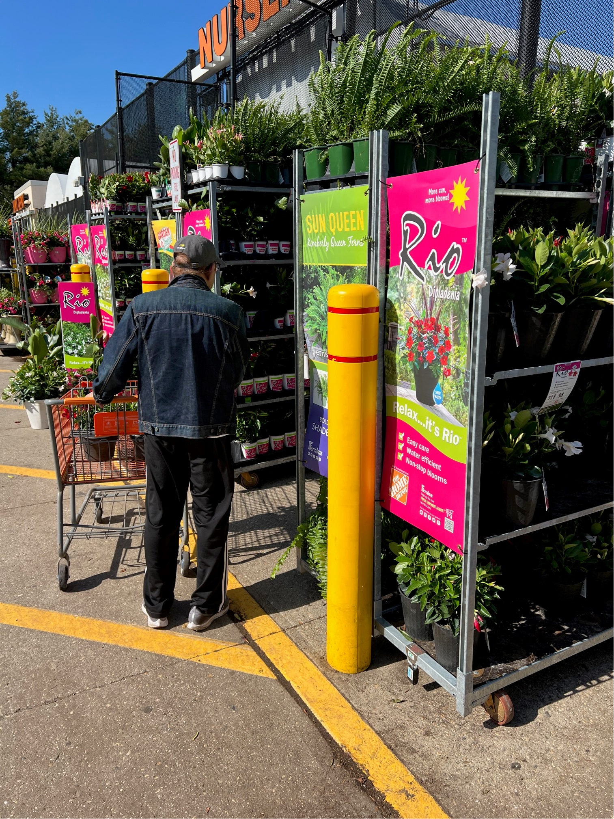
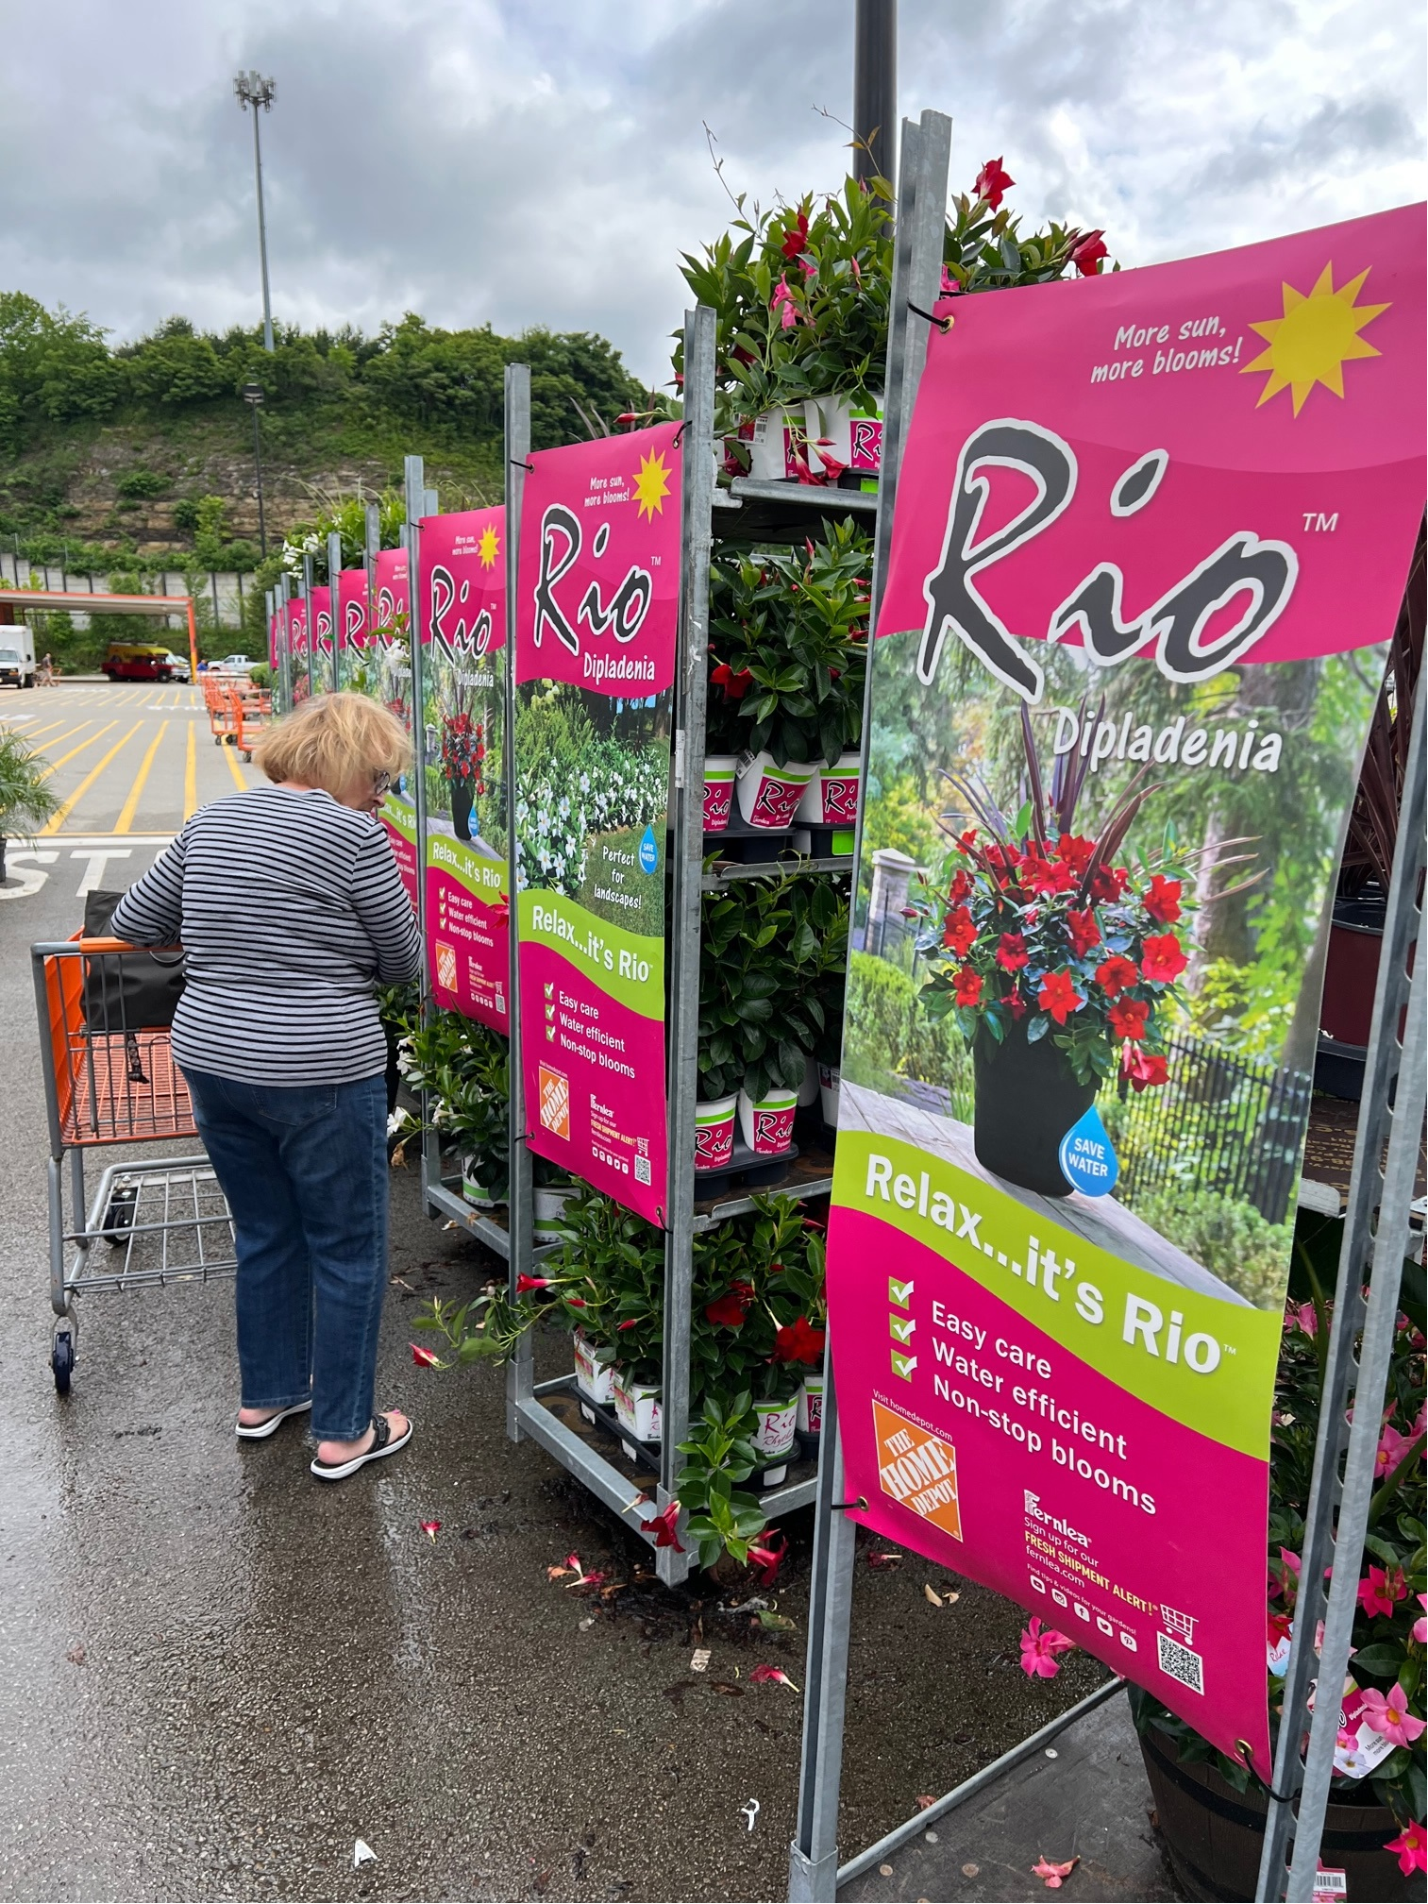
MERCHANDISING BEST PRACTICES
Shoppable
fernlea.com/Rio

