Slide 1
MERCHANDISING

Slide 2
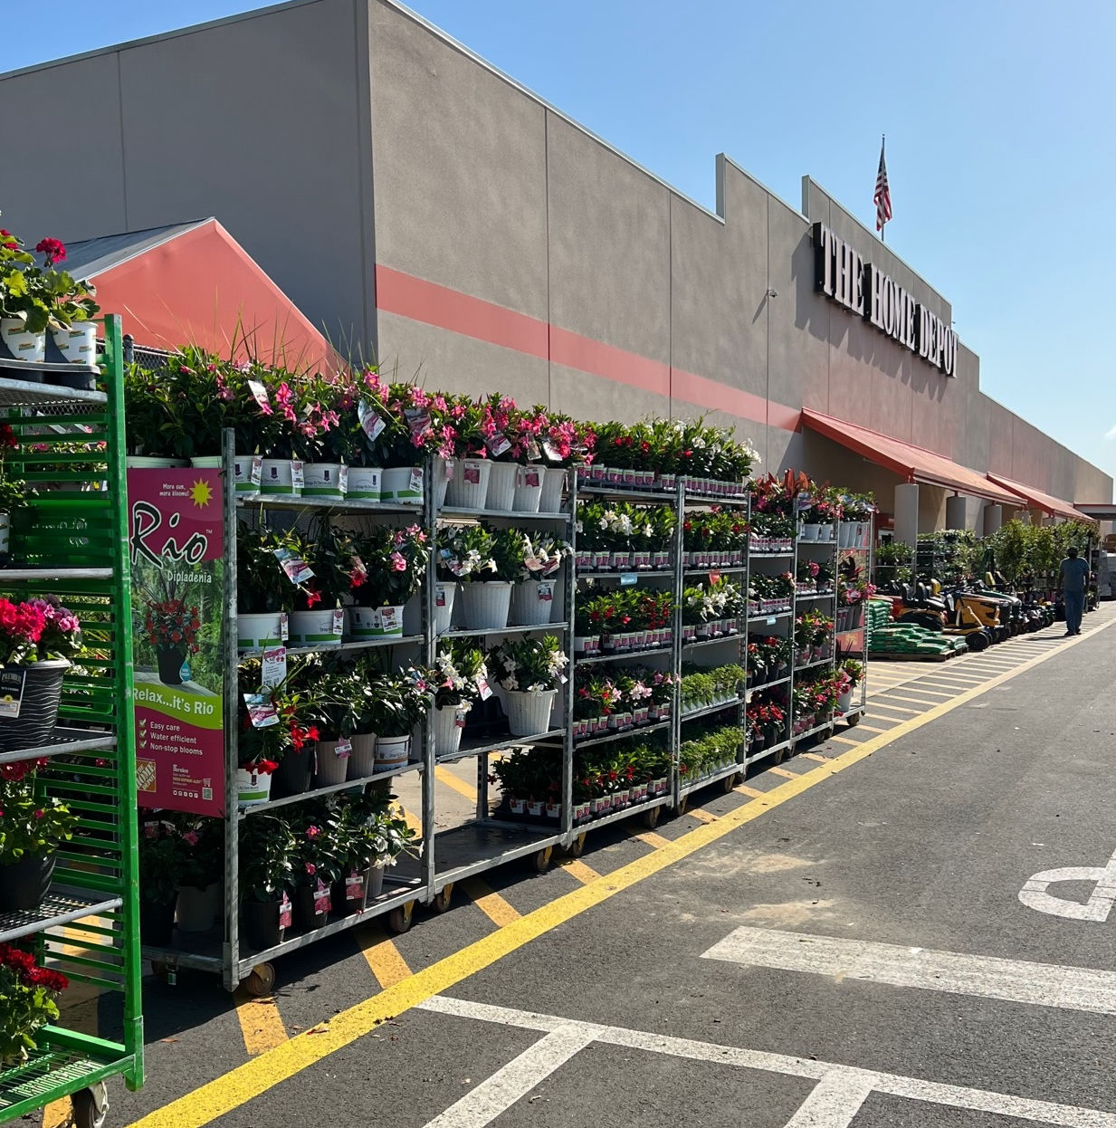
MERCHANDISING BEST PRACTICES
Place the Rio racks in Rio’s dedicated space.
STORE WITHIN A STORE
fernlea.com/Rio

Slide 3
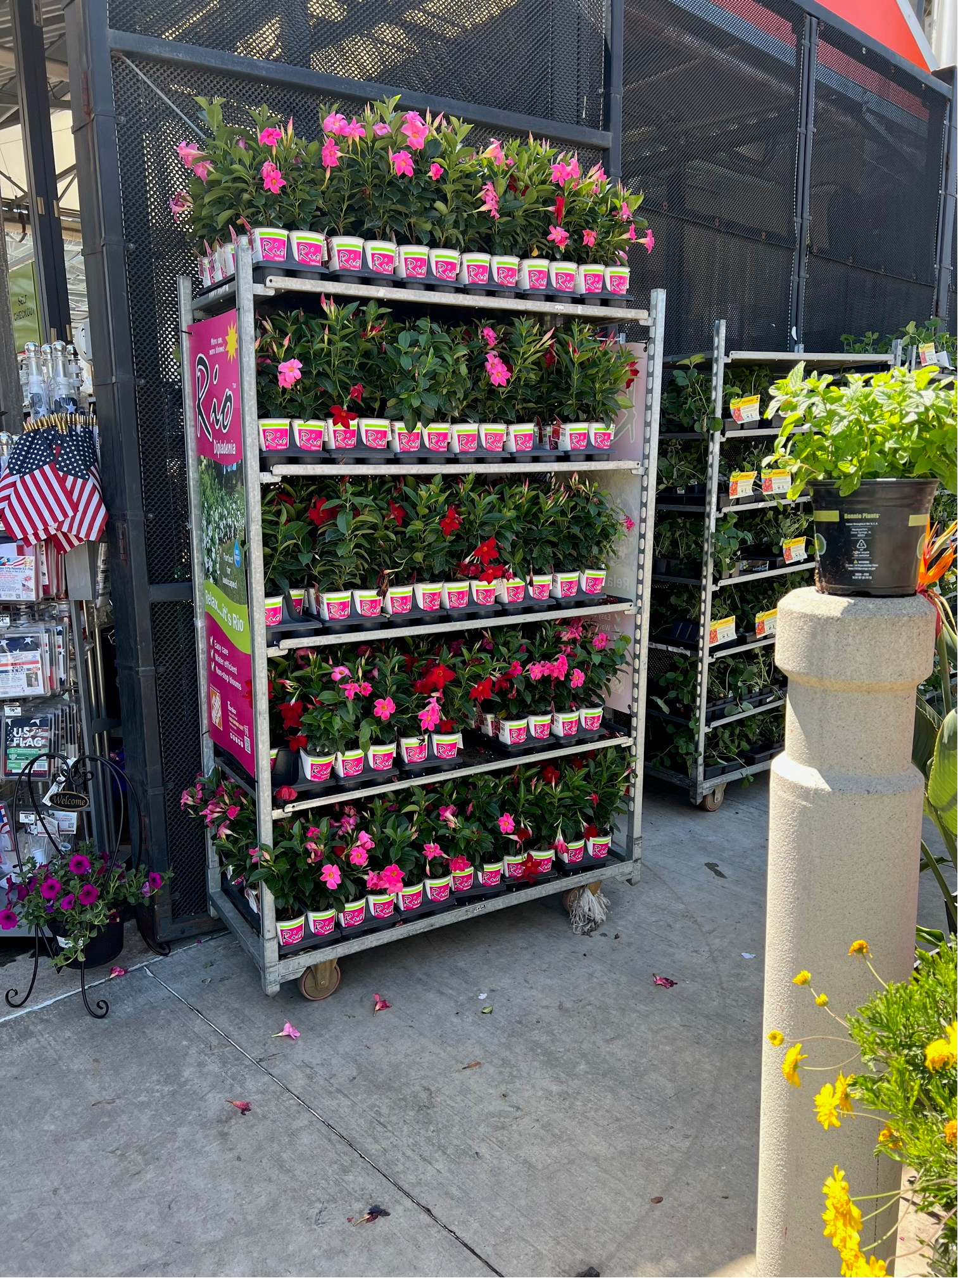
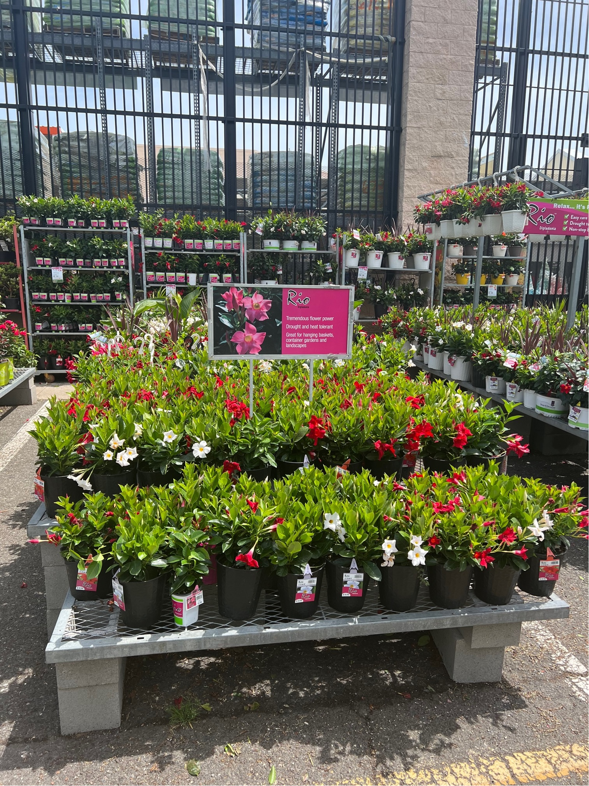
MERCHANDISING BEST PRACTICES
Gate Placement
Apron Placement
fernlea.com/Rio

