Slide 1

PRODUCT SHIPPING

Slide 2
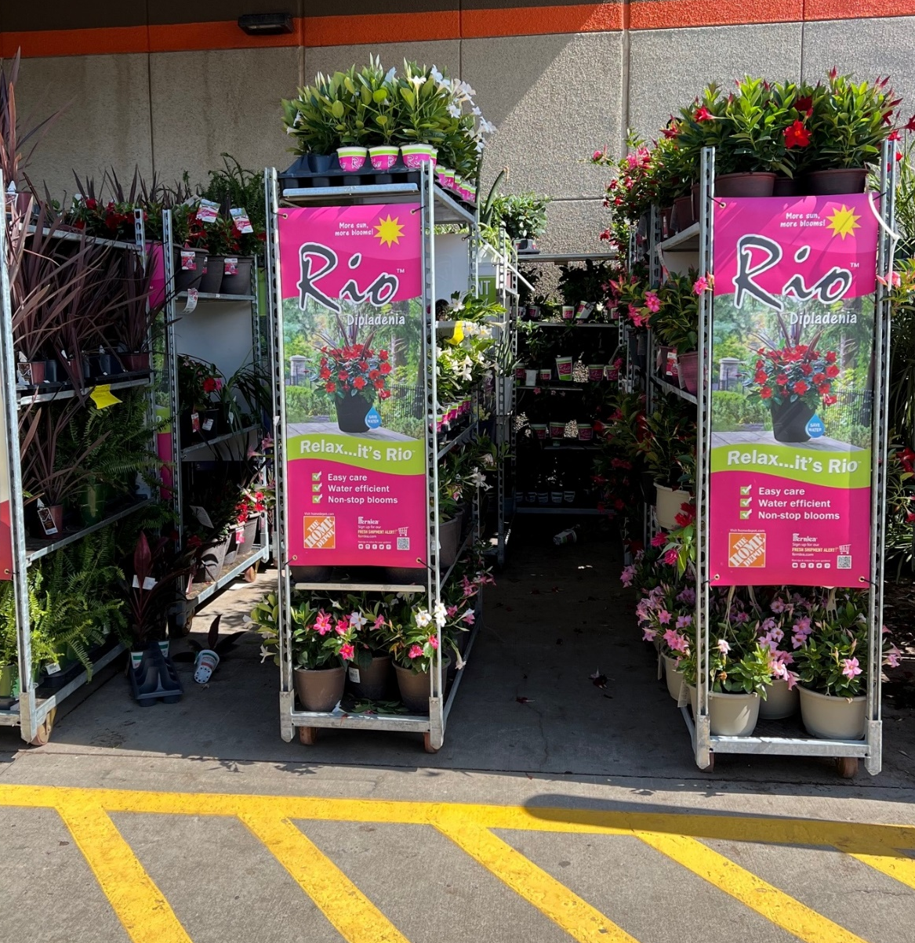
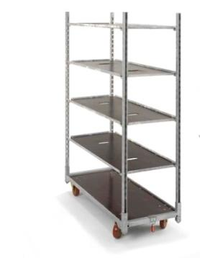
GREAT SHIPPING PRODUCTS
All Fernlea items are shipped on pre-merchandised ‘CC’ racks
50" x 21.75"

Slide 3

CC RACKS-RACK PICK UP
RIOTM DIPLADENIA
Each rack is scanned to the store, and notification is sent to CC at the time of shipping.
When racks are empty and ready for pick up at store, call the phone number found on the base of each rack
You can also use the CC app. via the Apple App Store or Google Play
Banners are to be removed from racks when empty.
If you require any assistance, finding CC delayed in picking up, contact Kim Tamcsu (kimberlyt@fernlea.com) at Fernlea for support.
For rack pick up: 1-866-498-9363
(also located on base of cart)
User ID: Fernleamerch@fernlea.com
Password: Fernlea1!

