Slide 1
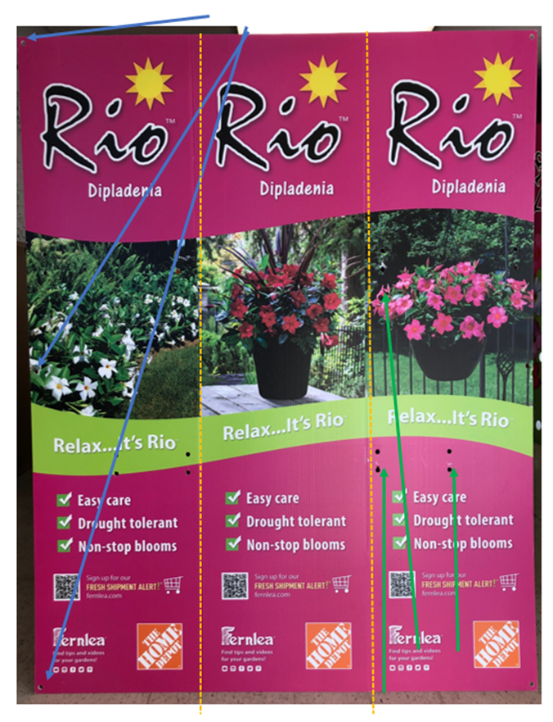
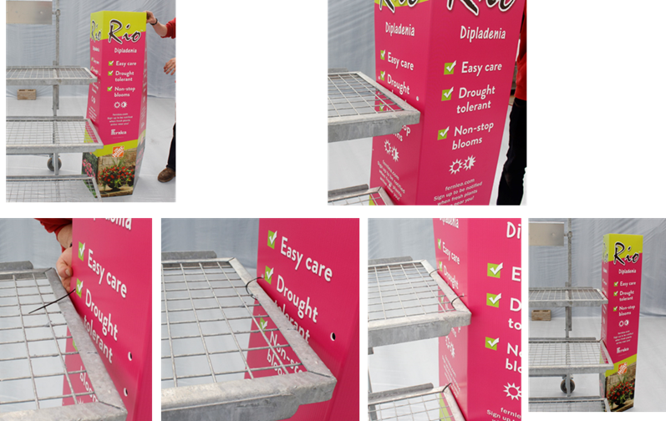
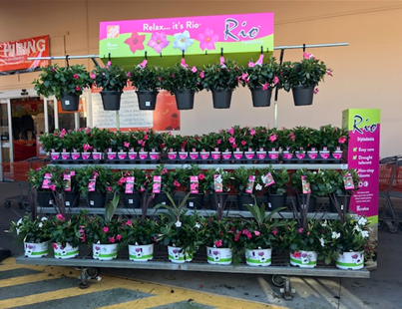
P.O.P. INSTRUCTIONS – MONSTER RACK TRIANGLE TOWER
Step 1 of 2
Small holes to zip-tie triangle closed
(3 holes on outer panels)
Step 2 of 2
Fold at heat bends (2) creating 3 panels
Then, line up holes against side of rack
Zip-tie upper holes to top shelf of rack, zip tie lower holes to middle rack
Zip tie triangle closed (top, middle, bottom) with seam at the back
Holes to zip-tie triangle to monster rack
(Holes on outer panels)
MONSTER RACK - COMPLETE
This is an example of the signage on the rack only.
(Rio product placement will vary)
Scored twice at 14”
Note: one score is less pronounced. If necessary, measure 14” from edge and you’ll find the bend.

Slide 2
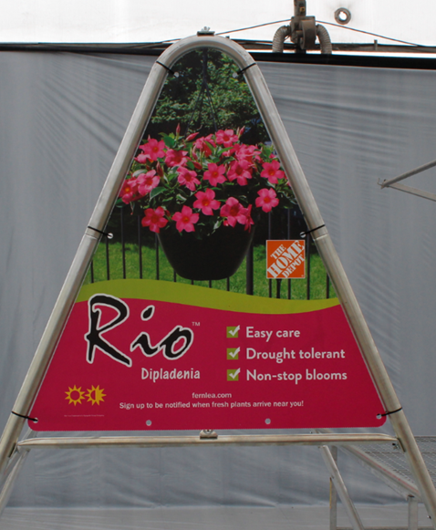
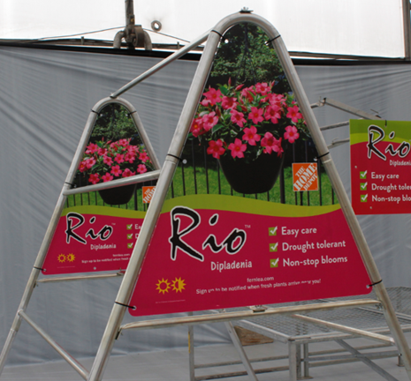
P.O.P. INSTRUCTIONS – BENCH / A-FRAME
A-FRAME
BENCH SIGNAGE
6 holes to zip-tie sign to A-Frame
Note: Header is 24” x 12”
Bench Poster
(4 holes in each poster can be zip tied to post).
Apron Header
6 holes

Slide 3
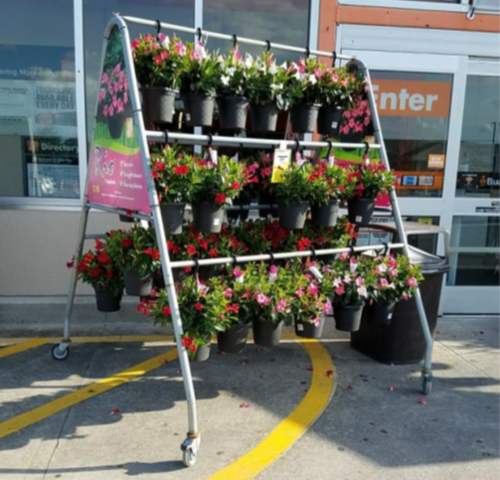
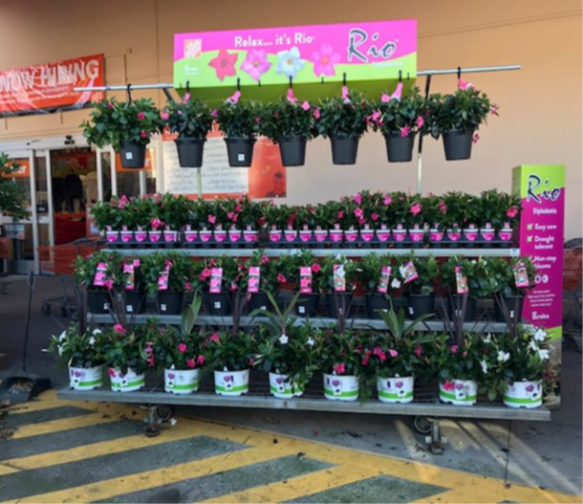
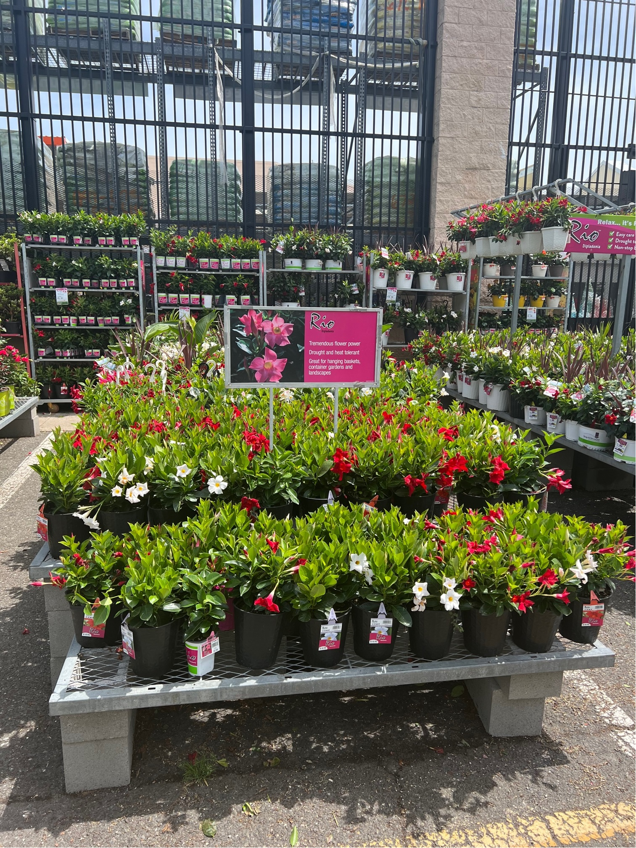
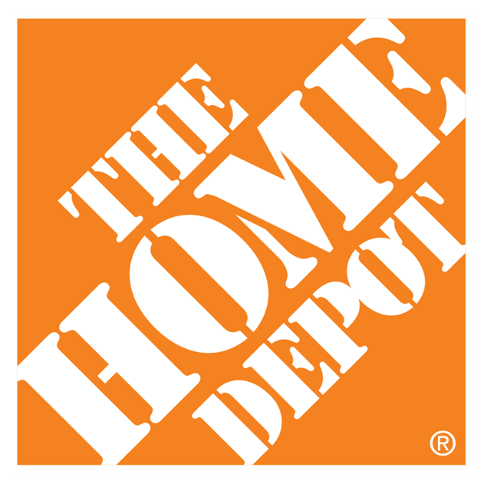
HOME DEPOT P.O.P. – IN-STORE
A-FRAME
MONSTER RACK
APRON TABLE

