Slide 1


RIO BRAND SUPPORT

Slide 2


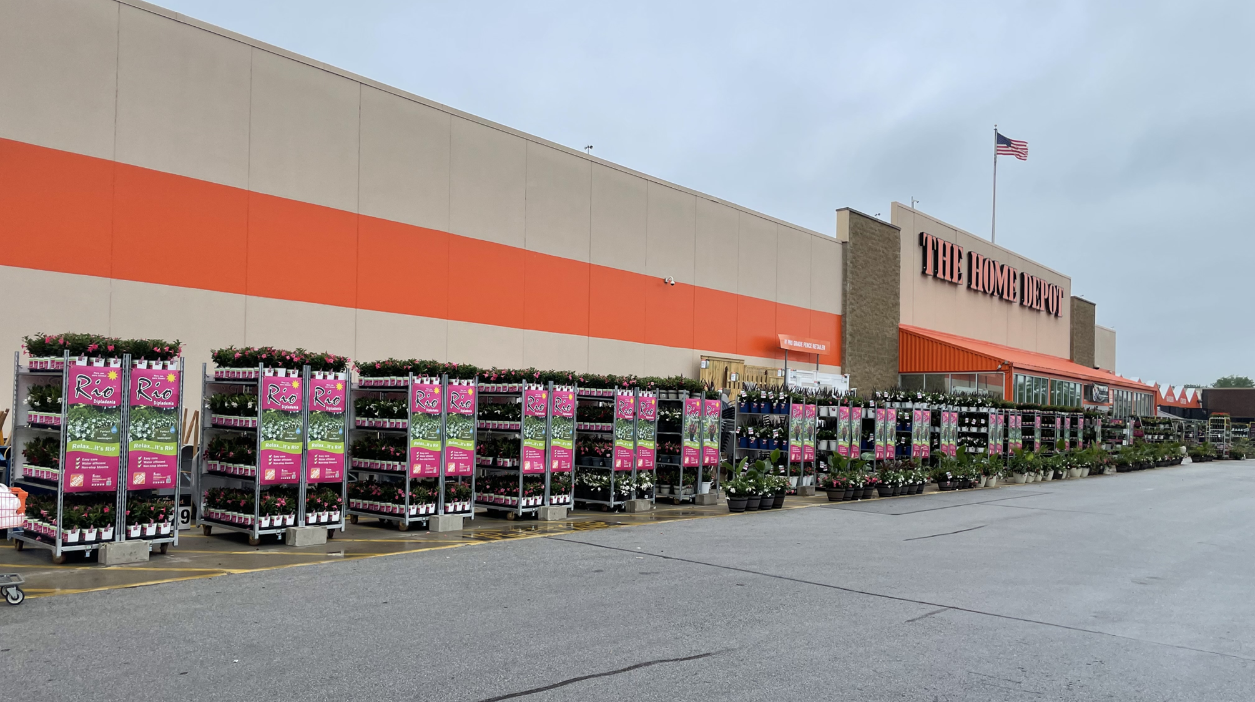

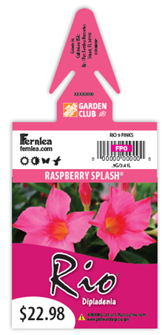
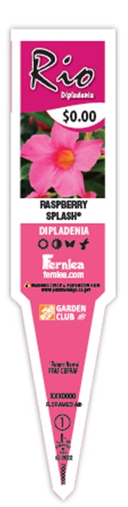
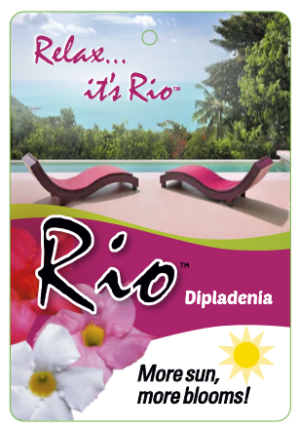
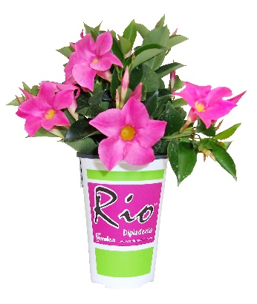
RIOTM IN-STORE BRAND SUPPORT
RIOTM DIPLADENIA
Supported by colorful and informative product packaging and point-of-purchase materials
LIFESTYLE CART BANNERS
BRANDED POTS AND TAGS

Slide 3





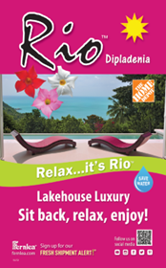


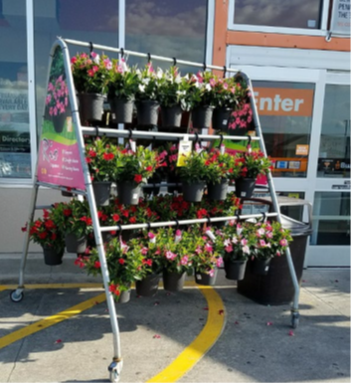
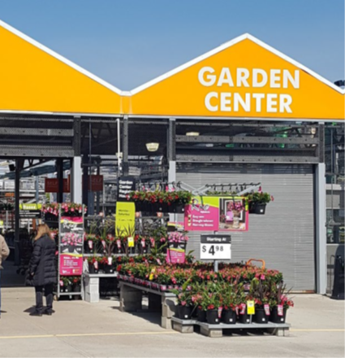


P.O.P. SIGNAGE – SET ON INITIAL DELIVERY
MONSTER RACK
TRIANGLE TOWER
MONSTER RACK
HEADER
POSTCARDS
APRON HEADER
(47x12)
A-FRAME

