Slide 1

MORE BRANDS IN STORE
RACK PROGRAMS

Slide 2


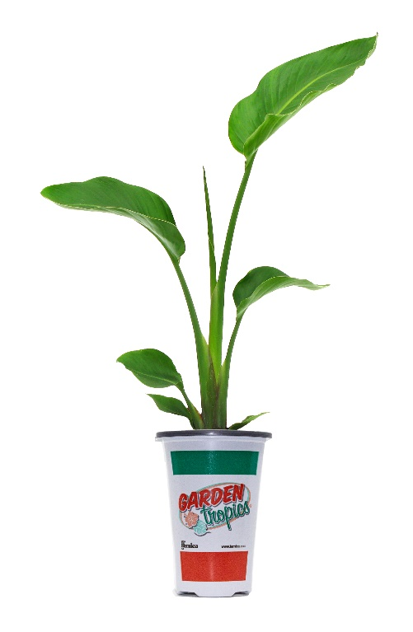
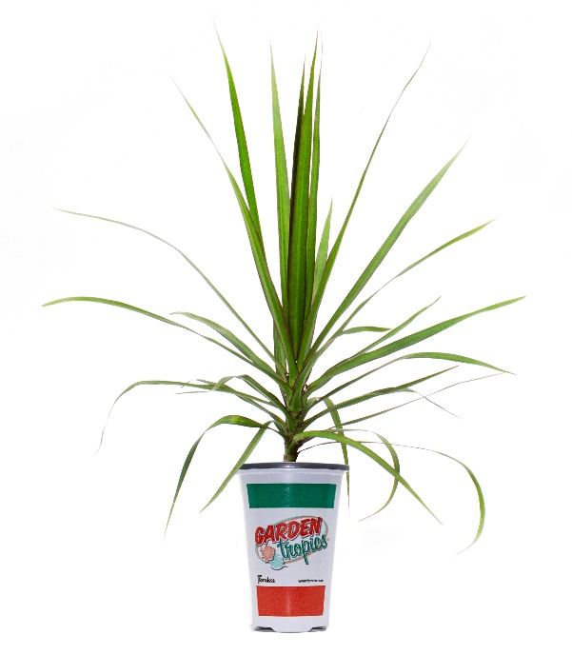
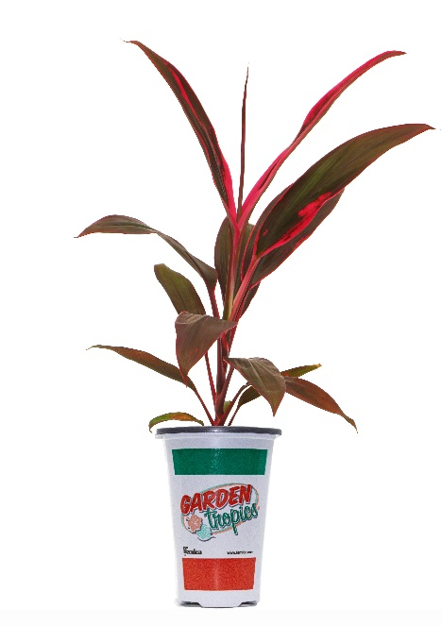
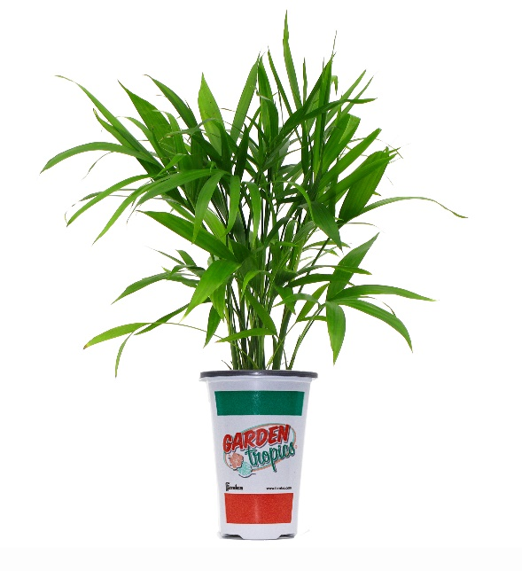
TROPICAL CENTERPIECES
IDEAL FOR THE DIY CONSUMER TO CREATE THEIR OWN RIO PLANTERS
Ruby Terminalis
Dracaena Marginata
Majesty Palm
Bird of Paradise
fernlea.com/gardentropics

Slide 3



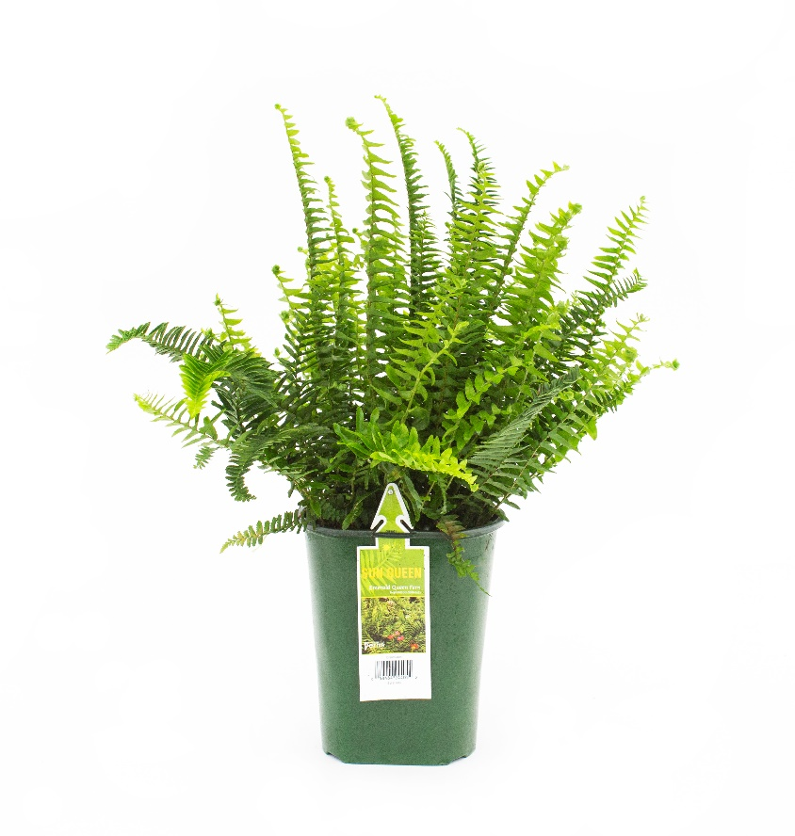
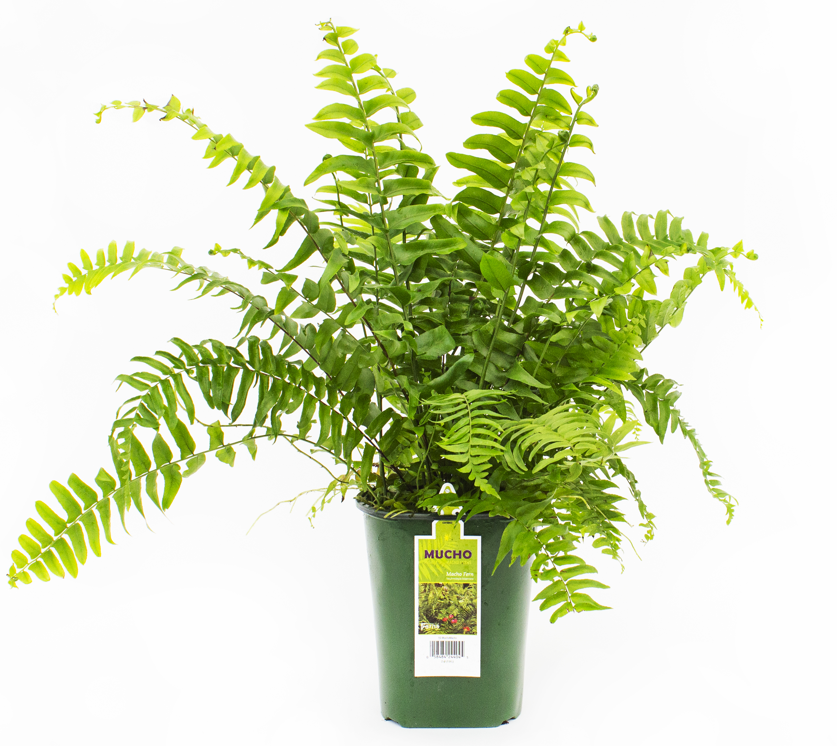
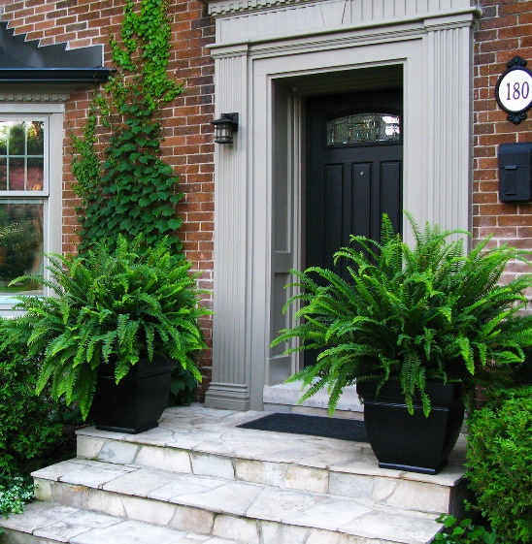
THE FERN COLLECTION
1 Gallon Ferns
fernlea.com/fabulousferns

Slide 4




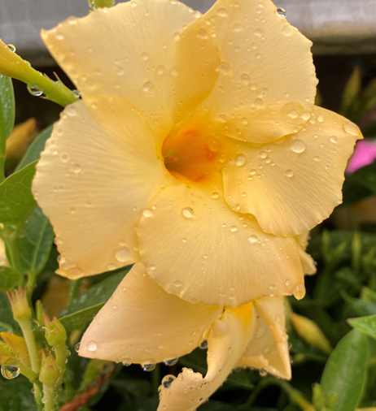
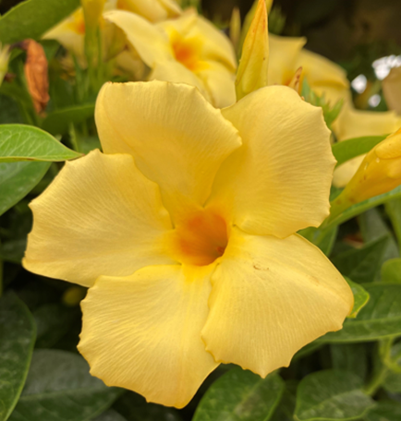
Only at
The success of Rio brings new opportunity
Available In:
Quarts
Patio Pots
fernlea.com/calypso

Slide 5


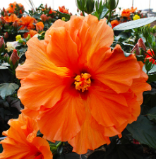
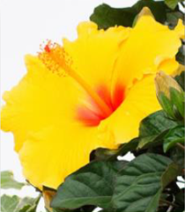
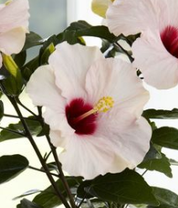
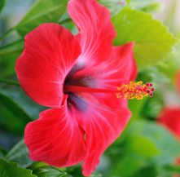
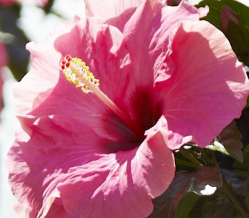
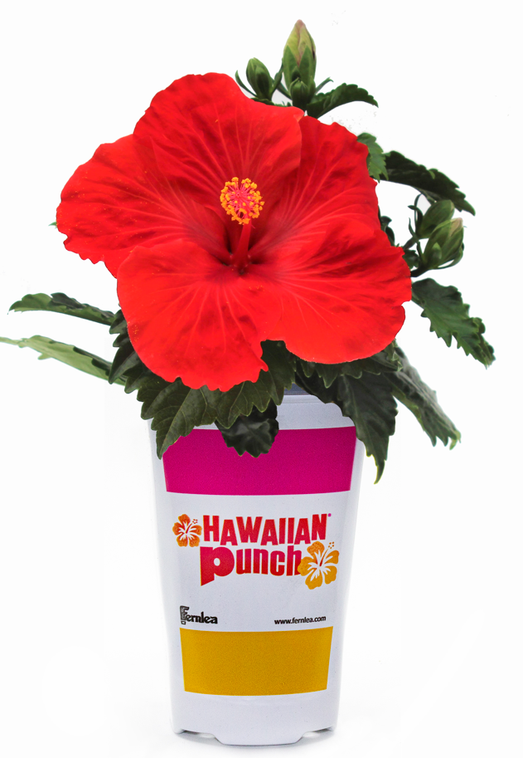
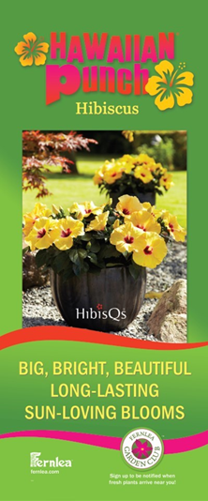
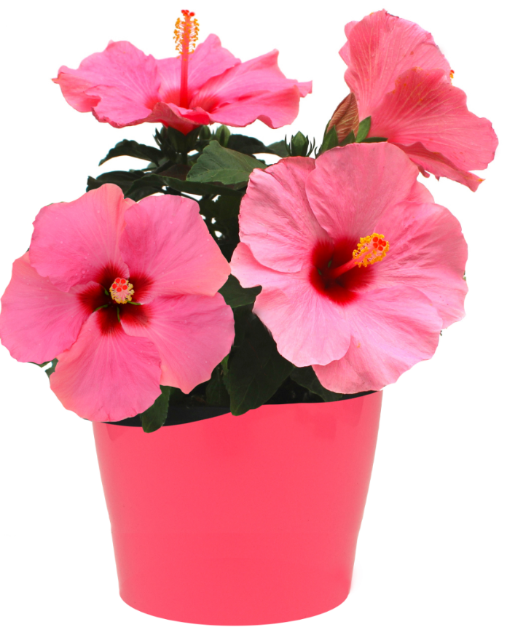
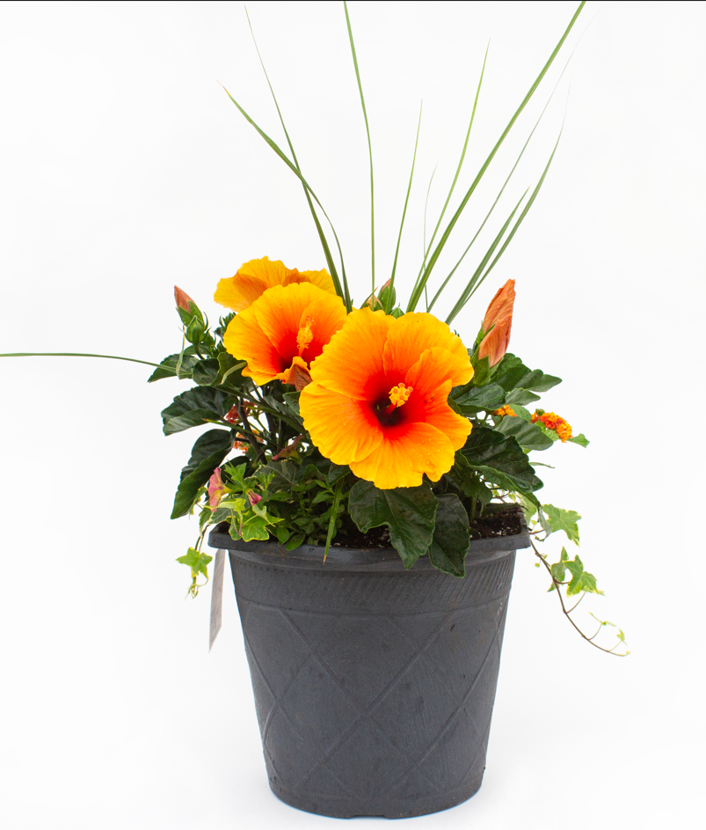
HAWAIIAN PUNCH HIBISCUS
NOT YOUR AVERAGE BLOOM!
BIG, BOLD, BEAUTIFUL BLOOMS
3-4 days of tropical color, whereas most blooms only last a day.
SUN-LOVING TROPICAL BEAUTY
Create a backyard oasis on the sun deck or around the pool.
VERSATILITY
Perfect for planters, tabletops and landscapes.
LOW MAINTENANCE:
Simple pruning will encourage more blooms for a fuller plant.
fernlea.com/hawaiianpunch

