Slide 1


PRODUCTS AVAILABLE

Slide 2
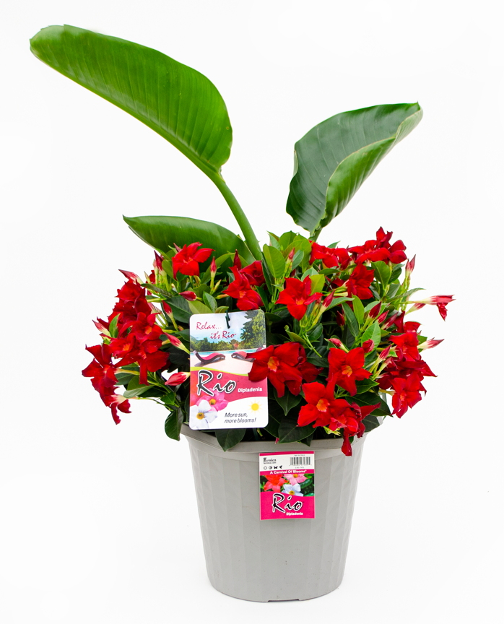
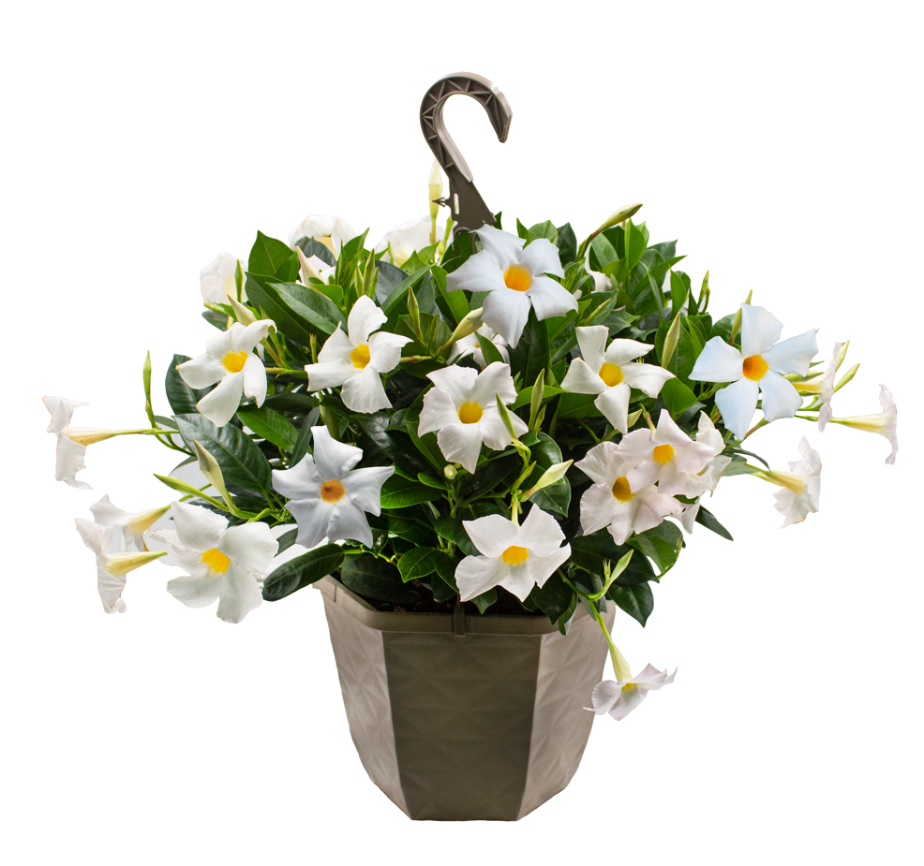
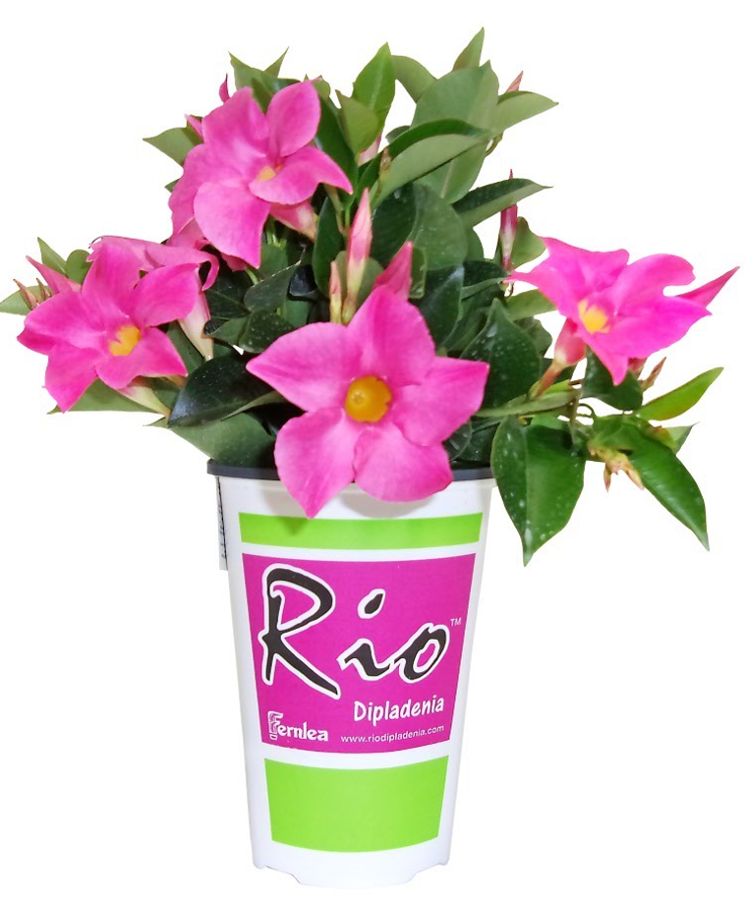
RIOTM DIPLADENIA TROPICALS
Rios are available in
Hanging Baskets, Planters and small Pots.
The quart size pot can be used to plant
in the ground to make gardens or for DIY planter
projects using your own planter pots.
See the DIY video at fernlea.com/Rio

Slide 3
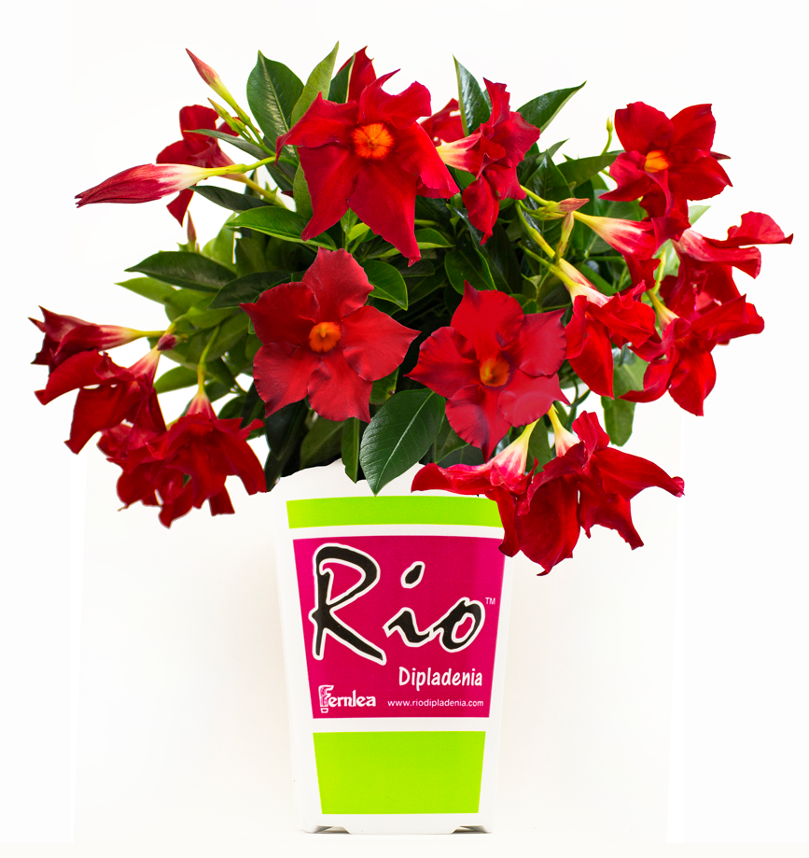
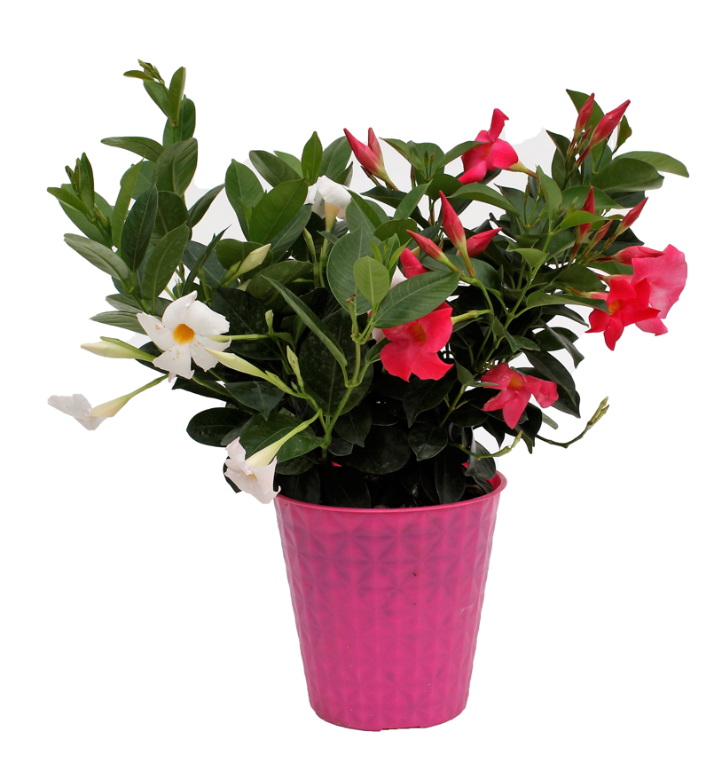
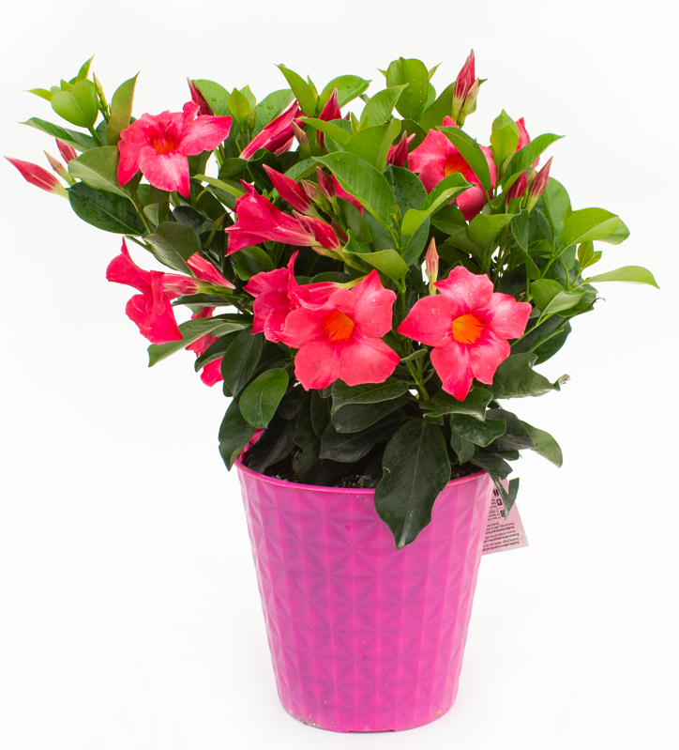

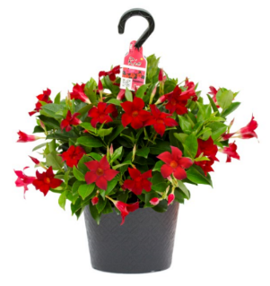
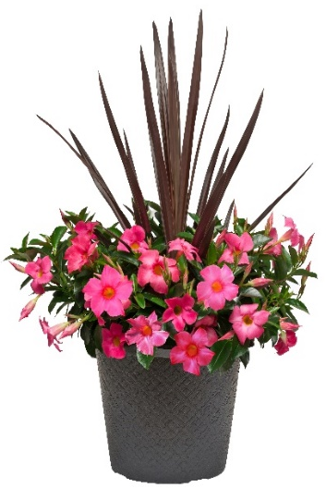
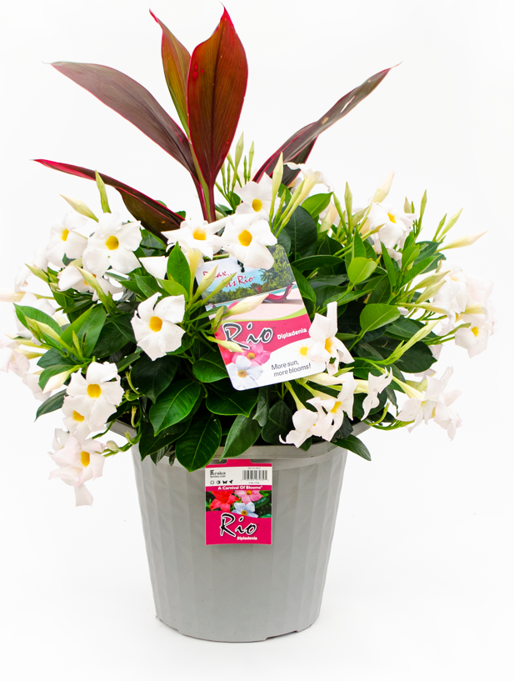
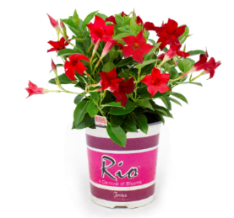
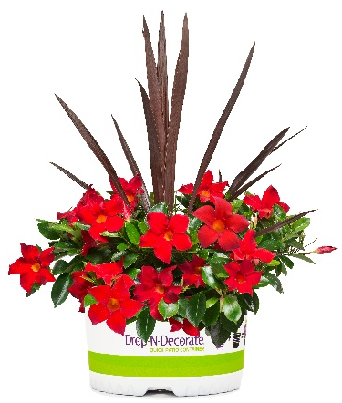
2024 PRODUCT LINEUP
Top 5 Rio Items – All Stores – All Season (Ad Items)
New National
Promo Item
Rio Quarts $6.98
#9 Rio Patio $19.98
Rio 1 Gallon $12.98
Pot Update
Pot Upgrade, Patio pots / painted finish; pink, red, white, & mixed
Pot update enhances Rio Brand
#10 Rio Hanging Basket $24.98
Adding white containers to #10HB and #12 Planter
(Late Season – May/June replaces quart & gallon)
#6 Rio
$8.98
#10 Drop N’ Decorate $31.98
#12 Rio Planter
$39.98
(2)
fernlea.com/Rio

Slide 4
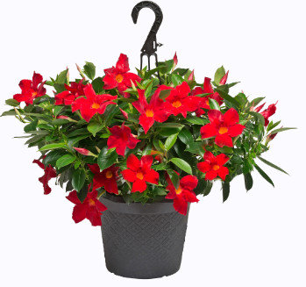
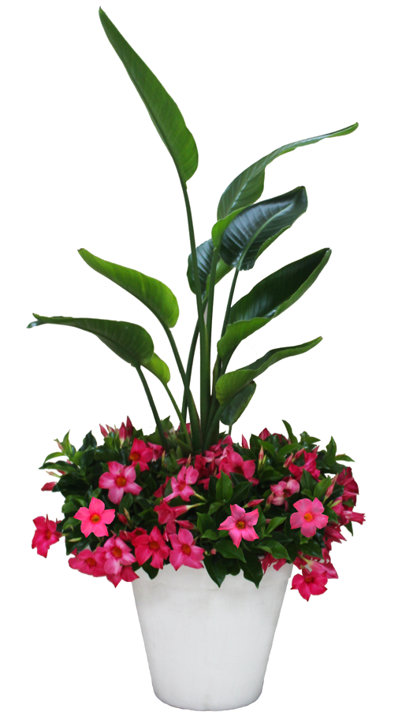
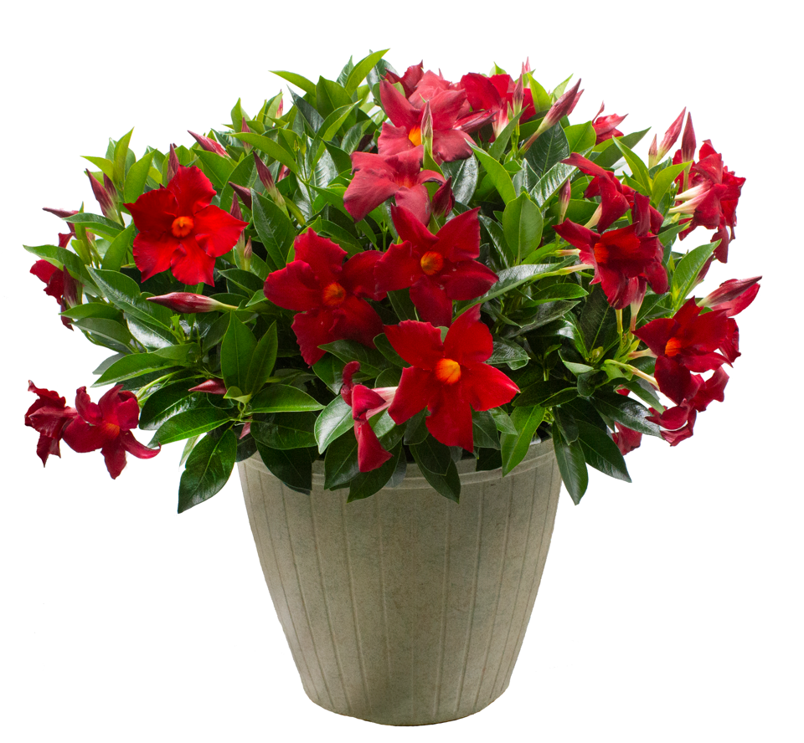



2024 PRODUCT LINEUP
PUSHING THE PREMIUM UPGRADES
May Not Ship to All Stores
#12 Hanging Basket $39.98
Painted finishes co-ordinate with #15 Planter
#12 Rio Patio Planter
$34.98
#15 Rio Planter $79.00
Rio Grande Planter $99.00
(3)
fernlea.com/Rio

Slide 5
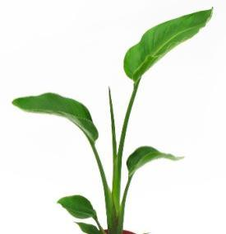
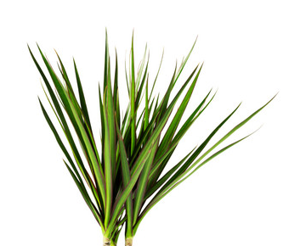
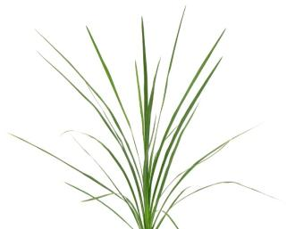
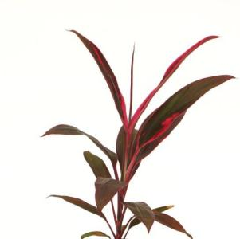
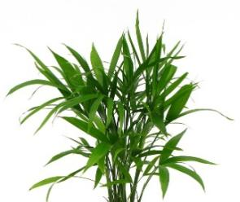
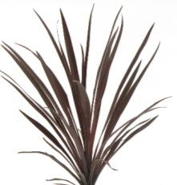
RIOTM DIPLADENIA – PLANTER COMPONENTS
WHAT’S IN OUR PLANTERS?
RIOTM DIPLADENIA
CENTERPIECE ‘THRILLER’ COMPONENTS
Dracaena Spike
Dracaena Marginata
Bird of Paradise (Big increase for 2024)
Majesty Palm – Market Specific
Cordyline
Terminalis
Red Star Cordyline
fernlea.com/Rio

