Slide 1
AVAILABLE COLORS

Slide 2
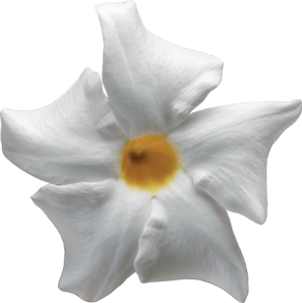
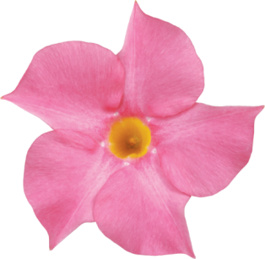
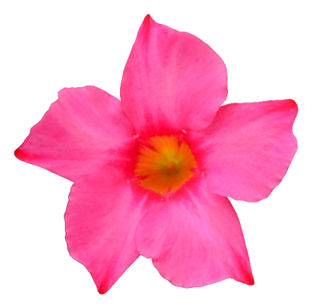
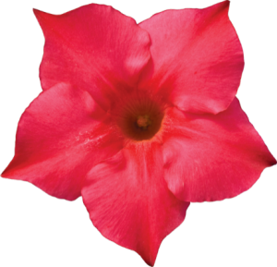
RIOTM DIPLADENIA – BLOOM COLORS
Available in 4 trumpet shaped bloom colors
Rio Dipladenia
Red
Rio Dipladenia
White
Rio Dipladenia
Pink
Rio Dipladenia
Raspberry Splash
fernlea.com/Rio

