Slide 1
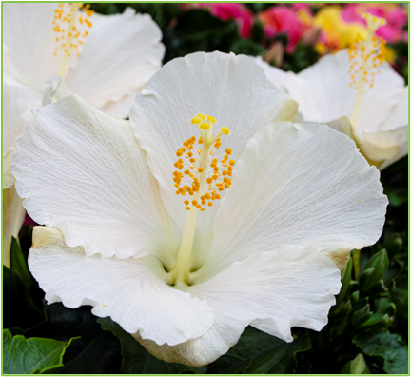
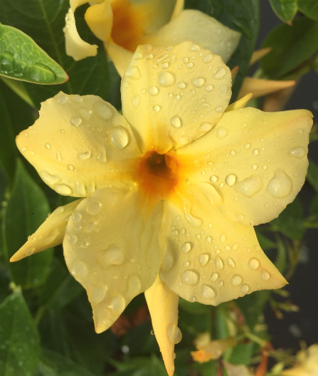
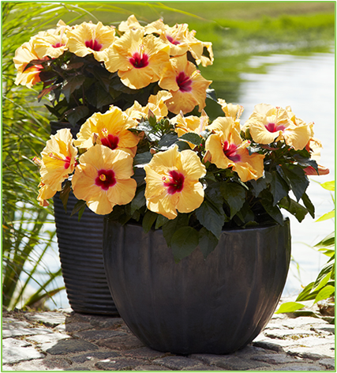
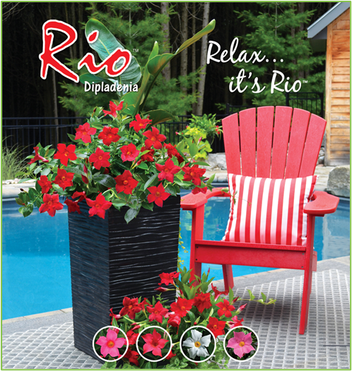
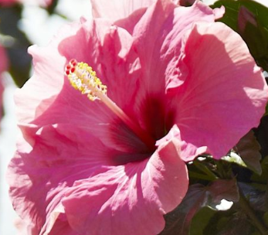
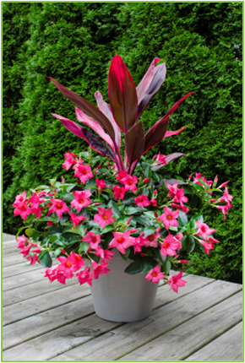
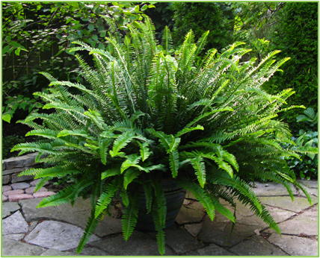
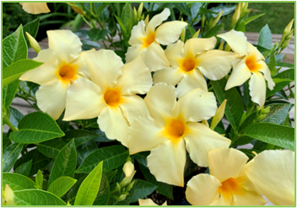
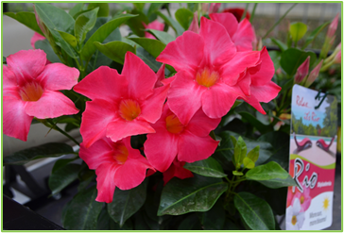
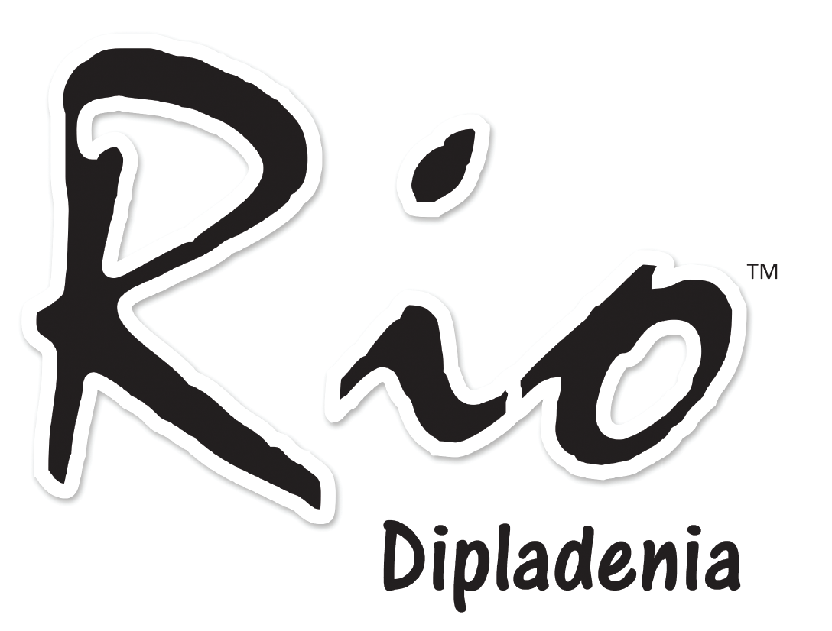
fernlea.com
MERCHANDISING PARTNERS MEETING
SPRING 2024

Slide 2
KEY INITIATIVES
Key Initiatives for 2024
Further improvements to merchandising app.
Improved real time tracking of deliveries.
Weekly sales updates and store performance.

Slide 3
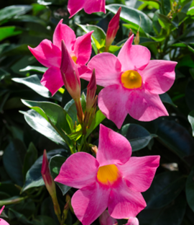
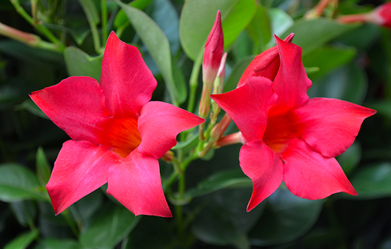
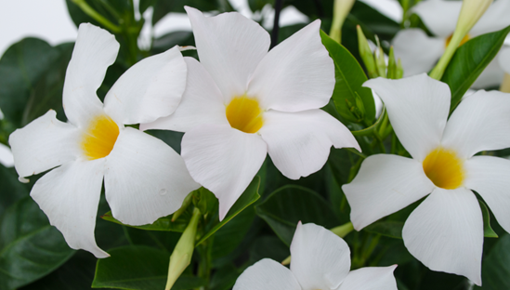
A CARNIVAL OF BLOOMS®
Rio is a bush-type dipladenia which is beautiful, durable, and low-maintenance
Rather than a climbing habit, Rios are non-stop bloomers that work very well in planters, garden beds, and hanging baskets
Approximately 80% of sales in 2023
Exclusive to THD
CANADA
www.riodipladenia.com
fernlea.com/Rio

Slide 4
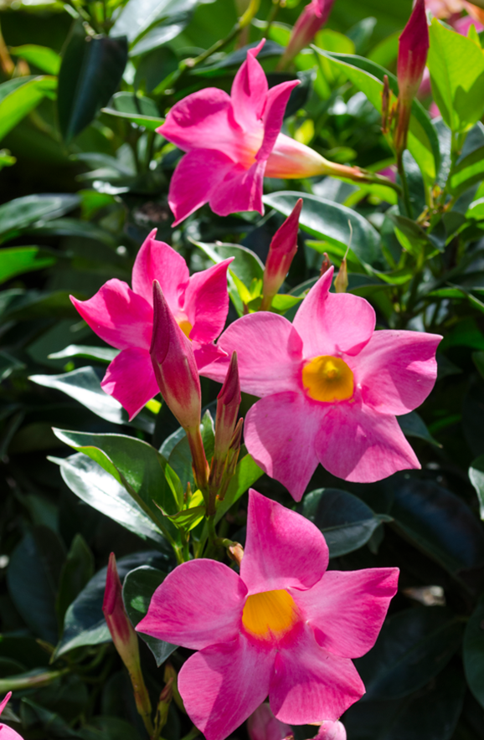
RIOTM DIPLADENIA KEY FEATURES
Rios require
no deadheading!
Blooms will fade and fall off. Rios will keep pushing out fresh blooms without deadheading.
fernlea.com/Rio

Slide 5
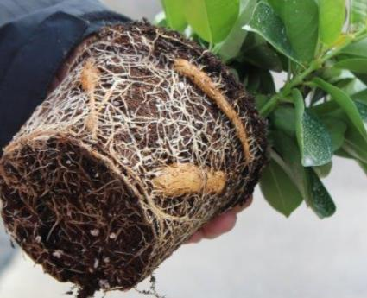
RIOTM DIPLADENIA KEY FEATURES
Very little watering required!
With built in water storage
in the form of “tubers”, Rios
store water beneath the soil
to use during dry spells.
Ideal for the part time gardener who isn’t available to water frequently at home or beach house .
Tubers
fernlea.com/Rio

Slide 6
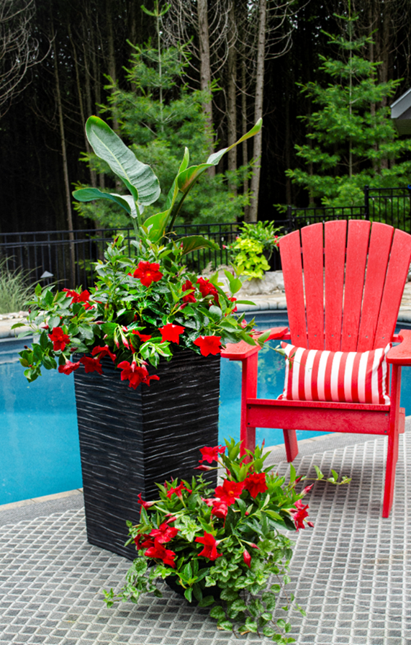
RIOTM DIPLADENIA KEY FEATURES
Rios will bloom all summer and well into the fall …until the first frost.
The one and done experience with Rio gives customers great value.
fernlea.com/Rio

Slide 7
RIO KEY FEATURES SUMMARY
• EASY CARE
– LOW MAINTENANCE, NO DEAD HEADING REQUIRED!
• BLOOMS ALL SUMMER
– EARLY SPRING THROUGH FIRST FROST IN AUTUMN
• LOVES SUN
- FULL SUN 4+ HOURS OF DIRECT SUNLIGHT IN ANY LOCATION
• COLD & HEAT TOLERANT
- MORE COLD TOLERANT THAN OTHER TROPICAL PLANTS. THEY CAN TAKE TEMPERATURES AS LOW AS 34 DEGREES (JUST ABOVE FREEZING) AND CONTINUE TO PERFORM IN HOT AND HUMID CLIMATES
• DROUGHT TOLERANT
– MORE THAN A WEEK WITHOUT WATER ONCE ESTABLISHED
fernlea.com/Rio

